Slide 1
Session #1:
Introduction to the Course

Slide 2
Some content for the slides may have been obtained from prescribed books and various other source on the Internet. The authors , hereby acknowledge all the contributors for their material and inputs and gratefully acknowledge those who made their course materials freely available online.

Slide 3
Agenda
Course Introduction
Outline of Course, Evaluation & Operation
Introducing Reinforcement Learning

Slide 4
What is Reinforcement Learning ?
Why Reinforcement Learning ?
reward based learning / feedback based learning
not a type of NN nor it is an alternative to NN. Rather it is an approach for learning
Autonomous driving, gaming
a goal-oriented learning based on interaction with environment

Slide 5
Course Objectives
Course Objectives:
Understand
the conceptual, mathematical foundations of deep reinforcement learning
various classic & state of the art Deep Reinforcement Learning algorithms
Implement and Evaluate the deep reinforcement learning solutions to various problems like planning, control and decision making in various domains
Provide conceptual, mathematical and practical exposure on DRL
to understand the recent developments in deep reinforcement learning and
to enable modelling new problems as DRL problems.

Slide 6
Learning Outcomes
Understand the fundamental concepts of reinforcement learning (RL), algorithms and apply them for solving problems including control, decision-making, and planning.
Implement DRL algorithms, handle challenges in training due to stability and convergence
Evaluate the performance of DRL algorithms, including metrics such as sample efficiency, robustness and generalization.
Understand the challenges and opportunities of applying DRL to real-world problems & model real life problems

Slide 7
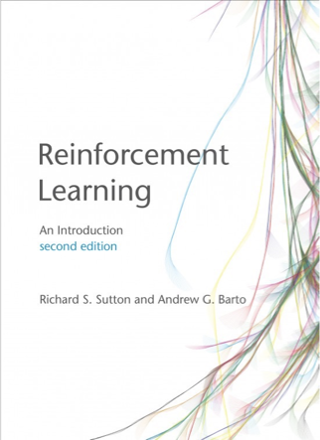
Course Operation
Textbooks
Reinforcement Learning: An Introduction,
Richard S. Sutton and Andrew G. Barto, Second Ed. , MIT Press

Slide 8
Course Operation
Evaluation
Two Quizzes for 5% each; Best of two will be taken for 5% ( in final grading);
Whatever be the points set for quizzes, the score will be scaled to 5%
NO MAKEUP, for whatever be the reason. Ensure to attend at least one of the quizzes.
Two Assignments - Tensorflow/ Pytorch / OpenAI Gym Toolkit → 25 %
Assignment 1: Partially Numerical + Implementation of Classic Algorithms - 10%
Assignment 2: Deep Learning based RL - 15%
Mid-Term Exam - 30% [ Only to be written in A4 pages, scanned and uploaded]
Comprehensive Exam - 40% [ Only to be written in A4 pages, scanned and uploaded]
Webinars/Tutorials
4 tutorials : 2 before mid-sem & 2 after mid-sem

Slide 9
Course Operation
•Schedule of Schedule of Quizzes
See the announcements for details
•Schedule of Assignments
See the announcements for details
•Schedule of Webinars
See the announcements for details

Slide 10
Course Operation
How to reach us ? (for any question on lab aspects, availability of slides on portal, quiz availability , assignment operations )
See the announcements for details
Plagiarism [ Important ]
All submissions for graded components must be the result of your original effort. It is strictly prohibited to copy and paste verbatim from any sources, whether online or from your peers. The use of unauthorized sources or materials, as well as collusion or unauthorized collaboration to gain an unfair advantage, is also strictly prohibited. Please note that we will not distinguish between the person sharing their resources and the one receiving them for plagiarism, and the consequences will apply to both parties equally.
In cases where suspicious circumstances arise, such as identical verbatim answers or a significant overlap of unreasonable similarities in a set of submissions, will be investigated, and severe punishments will be imposed on all those found guilty of plagiarism.

Slide 11
Reinforcement Learning
Reinforcement learning (RL) is based on rewarding desired behaviors or punishing undesired ones. Instead of one input producing one output, the algorithm produces a variety of outputs and is trained to select the right one based on certain variables – Gartner
When to use RL?
RL can be used in large environments in the following situations:
1.A model of the environment is known, but an analytic solution is not available;
2.Only a simulation model of the environment is given (the subject of simulation-based optimization)
3.The only way to collect information about the environment is to interact with it.

Slide 12
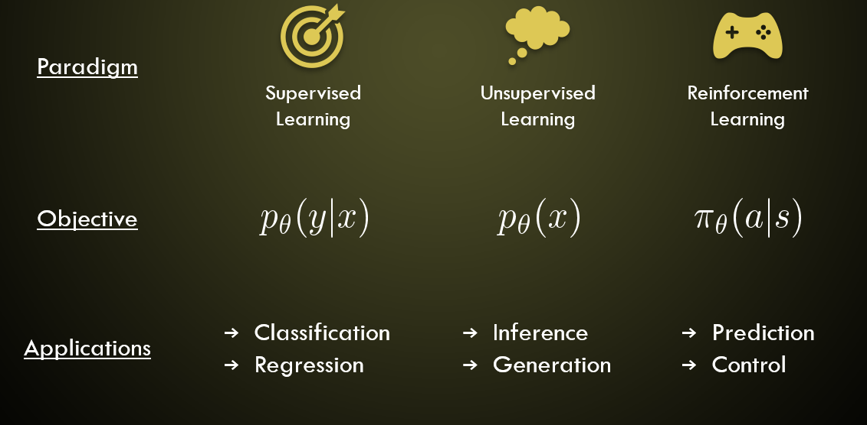
(Deep) Reinforcement Learning

Slide 13
Types of Learning
Criteria | Supervised ML | Unsupervised ML | Reinforcement ML
Definition | Learns by using labelled data | Trained using unlabelled data without any guidance. | Works on interacting with the environment
Type of data | Labelled data | Unlabelled data | No – predefined data
Type of problems | Regression and classification | Association and Clustering | Exploitation or Exploration
Supervision | Extra supervision | No supervision | No supervision
Algorithms | Linear Regression, Logistic Regression, SVM, KNN etc. | K – Means, C – Means, Apriori | Q – Learning, SARSA
Aim | Calculate outcomes | Discover underlying patterns | Learn a series of action
Application | Risk Evaluation, Forecast Sales | Recommendation System, Anomaly Detection | Self Driving Cars, Gaming, Healthcare

Slide 14
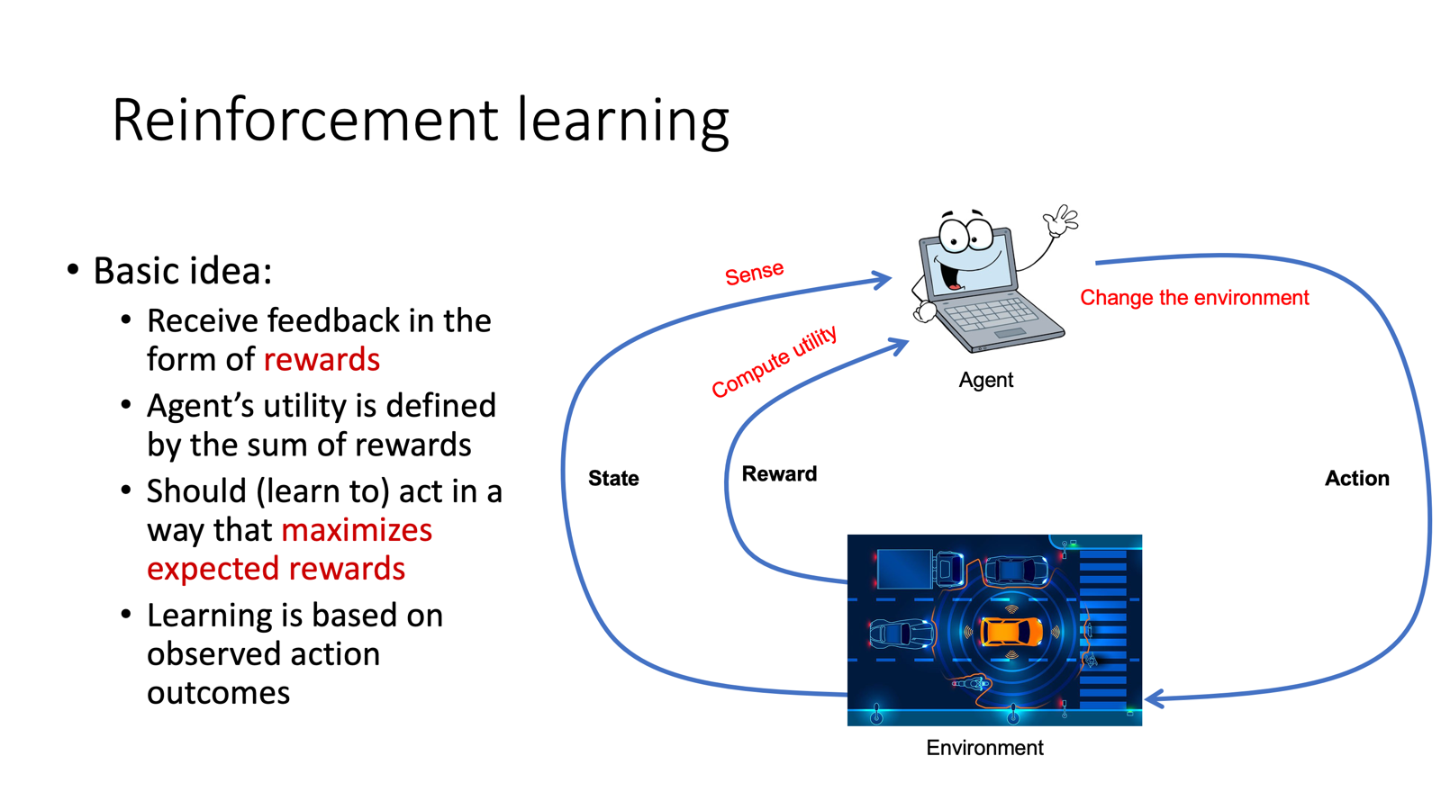

Slide 15
Characteristics of RL
•No supervision, only a real value or reward signal
•Decision making is sequential
•Time plays a major role in reinforcement problems
•Feedback isn’t prompt but delayed

Slide 16
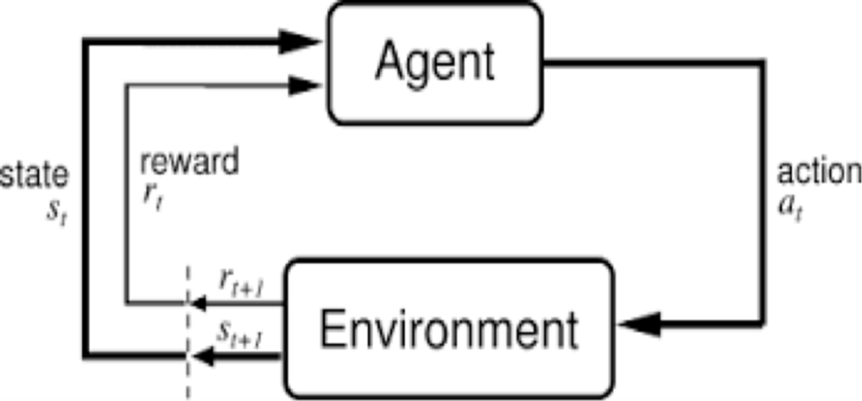
Elements of Reinforcement Learning
Beyond the agent and the environment, one can identify four main sub-elements of a reinforcement learning system: a policy, a reward , a value function, and, optionally, a model of the environment.

Slide 17
Elements of Reinforcement Learning
•Agent
An entity that tries to learn the best way to perform a specific task.
In our example, the child is the agent who learns to ride a bicycle.
•Action (A) -
What the agent does at each time step.
In the example of a child learning to walk, the action would be “walking”.
A is the set of all possible moves.
In video games, the list might include running right or left, jumping high or low, crouching or standing still.

Slide 18
Elements of Reinforcement Learning
•State (S)
Current situation of the agent.
After doing performing an action, the agent can move to different states.
In the example of a child learning to walk, the child can take the action of taking a step and move to the next state (position).
•Rewards (R)
Feedback that is given to the agent based on the action of the agent.
If the action of the agent is good and can lead to winning or a positive side then a positive reward is given and vice versa.

Slide 19
Elements of Reinforcement Learning
•Environment
Outside world of an agent or physical world in which the agent operates.
Formal Definition - Reinforcement learning (RL) is an area of machine learning concerned with how intelligent agents ought to take actions in an environment in order to maximize the notion of cumulative reward.

Slide 20
Elements of Reinforcement Learning
Goal of RL - maximize the total amount of rewards or cumulative rewards that are received by taking actions in given states.
•Notations –
a set of states as S,
a set of actions as A,
a set of rewards as R.
At each time step t = 0, 1, 2, …, some representation of the environment’s state S_{t} ∈ S is received by the agent. According to this state, the agent selects an action A_{t} ∈ A which gives us the state-action pair (S_{t} , A_{t}). In the next time step t+1, the transition of the environment happens and the new state S_{t+1} ∈ S is achieved. At this time step t+1, a reward R_{t+1} ∈ R is received by the agent for the action A_{t} taken from state S_{t}.

Slide 21
Elements of Reinforcement Learning
Policy (π)
Policy in RL decides which action will the agent take in the current state.
It tells the probability that an agent will select a specific action from a specific state.
Policy is a function that maps a given state to probabilities of selecting each possible action from the given state.
•If at time t, an agent follows policy π, then π(a|s) becomes the probability that the action at time step t is a_{t=a} if the state at time step t is S_{t=s} .The meaning of this is, the probability that an agent will take an action a in state s is π(a|s) at time t with policy π.

Slide 22
Elements of Reinforcement Learning
Value Functions
a simple measure of how good it is for an agent to be in a given state, or how good it is for the agent to perform a given action in a given state.
Two types
State- value function
Action-value function

Slide 23
Elements of Reinforcement Learning
Model of the environment
﻿mimics the behavior of the environment, or more generally, that allows inferences to be made about how the environment will behave.
For example, given a state and action, the model might predict the resultant next state and next reward.
Models are used for planning

Slide 24
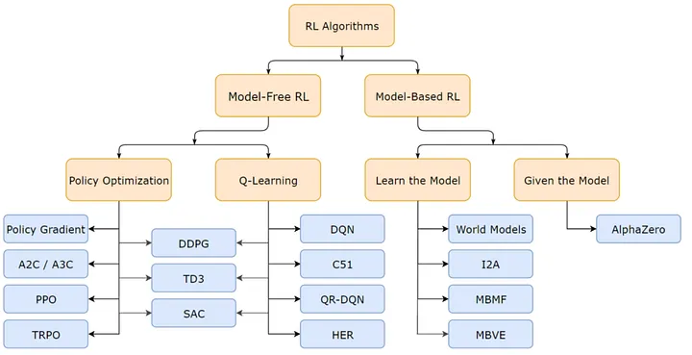
(Deep) Reinforcement Learning
From OpenAI

Slide 25
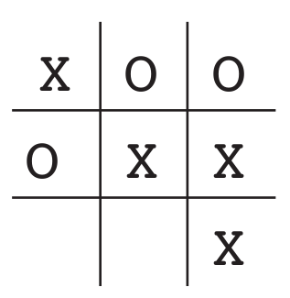
Tic-Tac-Toc
Two players take turns playing on a three-by-three board. One player plays Xs and the other Os until one player wins by placing three marks in a row, horizontally, vertically, or diagonally
Assumptions
playing against an imperfect player, one whose play is sometimes incorrect and allows you to win
Aim
How might we construct a player that will find the imperfections in its opponent’s play and learn to maximize its chances of winning?

Slide 26
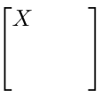
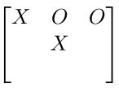
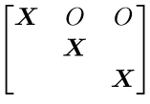
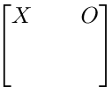

Tic-Tac-Toc
States
Initial Values
0.5
0.5
Learning Task: Play as many times against the opponent and learn the values
1.0
0
Set up a table of states initial values
O
O
…
…

Slide 27
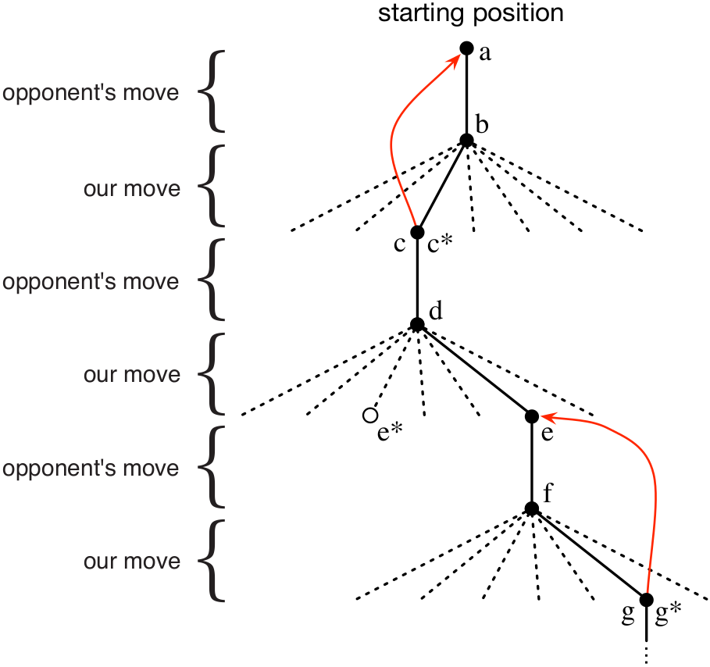

Tic-Tac-Toc
States
Initial Values
0.5
0.5
S_{t} - state before greedy move
S_{t+1} - state after greedy move
1.0
O
0
O
…
…

Slide 28
Tic-Tac-Toc
Temporal Difference Learning Rule
𝜶- Step Size Parameter

Slide 29
Tic-Tac-Toc
Questions:
What happens if 𝜶 is gradually made to 0 over many games with the opponent?
What happens if 𝜶 is gradually reduced over many games, but never made 0?
What happens if 𝜶 is kept constant throughout its life time?
Temporal Difference Learning Rule
𝜶- Step Size Parameter

Slide 30
Tic-Tac-Toc
Key Takeaways:
Learning while interacting with the environment (opponent).
We have a clear goal
Our policy is to make moves that maximizes our chances of reaching goal
Use the values of states most of the time (exploration) and explore rest of the time.
Temporal Difference Learning Rule
𝜶- Step Size Parameter

Slide 31
Tic-Tac-Toc
Reading Assigned:
Identify how this reinforcement learning solution is different from solutions using minimax algorithm and genetic algorithms.
Post your answers in the discussion forum;
Temporal Difference Learning Rule
𝜶- Step Size Parameter

Slide 32
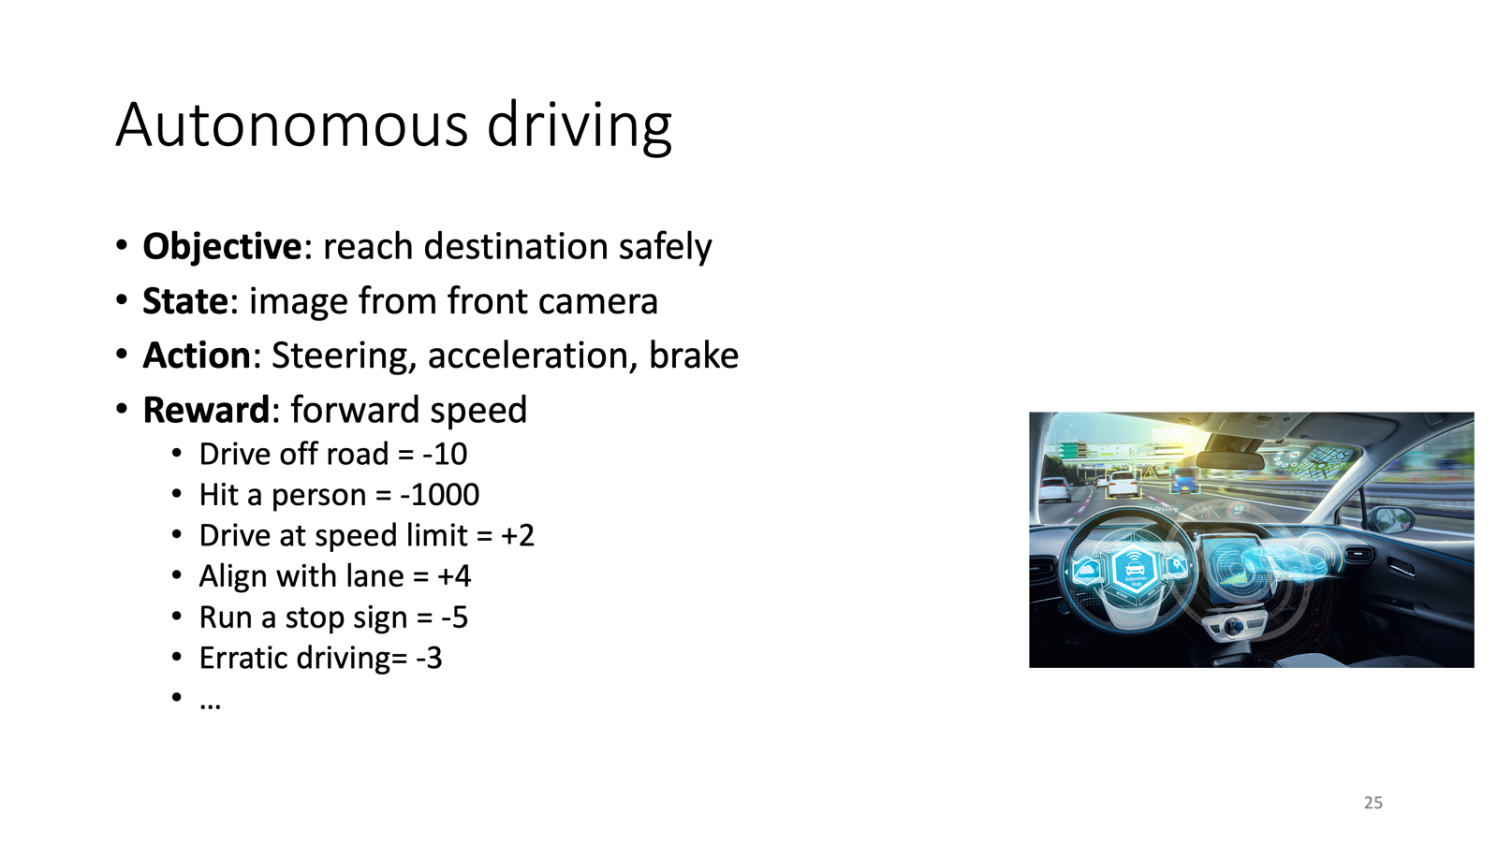

Slide 33


Slide 34
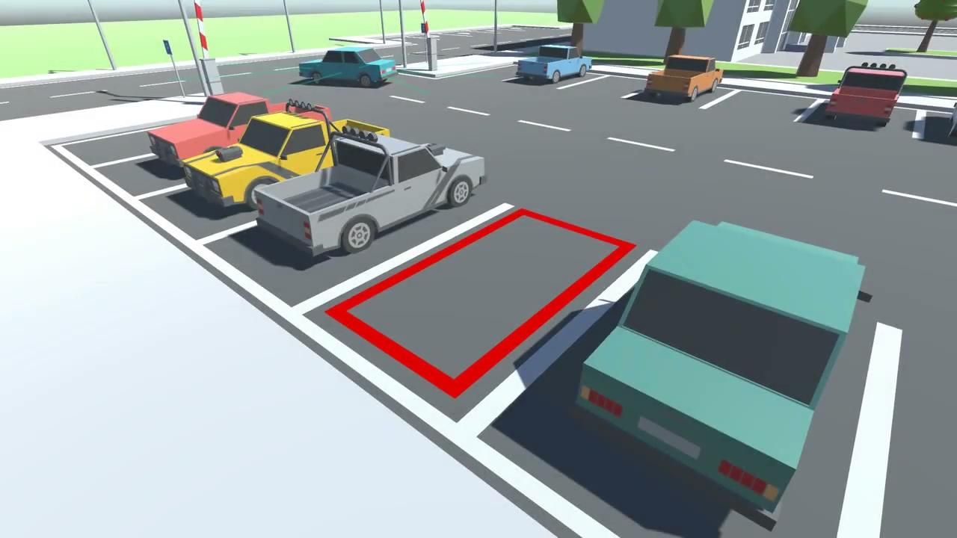

Slide 35
References for today’s session
Chapter 1 - Reinforcement Learning: An Introduction, Richard S. Sutton and Andrew G. Barto, Second Ed. , MIT Press

Slide 36
End of Session #1
Thank you

